Slide 1

Object Orientated Software Engineering
Requirements
By Derek Somerville

Slide 2

Admin
Zoom

Slide 3
Intended Learning Outcomes
Understand different requirements and software modelling techniques.

Slide 4
Requirement Gathering - Overview
Scope
Prototype
Questions
Interviews
Group Meetings
User Stories

Slide 5
Scope
The scope is a high level description
What it will achieve and not
Boundaries what is in and out
Business Benefits
Stakeholders

Slide 6
Requirements
Identify the stakeholders
Identify decision makers
Who has the knowledge
Get the detailed requirement
Tie back development and testing to requirements

Slide 7
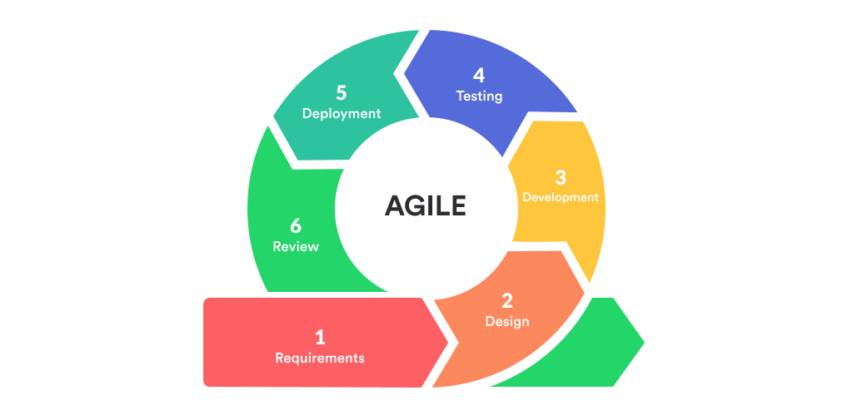
Requirements

Slide 8
Prototype
The requirements are unknow or unclear
The technology is unknow
It is a new team
Gain early knowledge and early feedback

Slide 9
Questions
Likert Scale
Categorical
True/False
Closed question
Open Ended

Slide 10
Interview Questions – Likert Scale

Slide 11
Interview Questions – Category

Slide 12
Interview Questions - Types
Likert Scale – How easy is the game 1. easy, 2. Moderate 3. Hard
Categorical game – How many cards are initially dealt 1,2,3,4,5,6,7,8,All,Other
True/False – Is Ace high Yes, No or Both

Slide 13
Interview Questions - Types
True/False – Are cards dealt more than once True or False
Closed question – What is your name, what school did you attend
Open Ended – How do you win in the card game

Slide 14

Structured Interview

Slide 15
Structured Interview
A set list of questions
Easy to compare with other participants
Consistency
No follow-up for lack of detail
Interview does no need to be skilled

Slide 16
Survey
A set list of questions
Easy to compare with other participants
Consistency
No follow-up for lack of detail
No interviewed
Large scale
If no open can look at statistics

Slide 17
Un-Structured Interview
Open questions, with no set list
Difficult to compare with other participants
No consistency
Follow-up for lack of detail
Interview does need to be skilled

Slide 18
Semi-Structured Interview
A list of set questions
Follow-up unscripted questions depend on answers

Slide 19
Semi-Structured Interview - Discuss
Please split into groups
What are the advantages and disadvantages of a semi structed interview

Slide 20
Semi-Structured Interview - Solution
Advantages
include more flexibility in interviewing
More complete responses when unclear answers can be further discussed
Disadvantages
include lack of consistency
influenced by unskilled interviewer

Slide 21
Group Meetings
Focus Groups
Requirement Gathering Workshop

Slide 22

Group Meetings – Focus Group
Notes:
Summer School Focus Group
No ice break, most had met
Ten people with range of ways the summer school was done
Open questions for view on summer school
I was the moderator and Prof Quintin Cutts was the scribe, and recorded
Observer Interference – People may have been nice in front of my boss

Slide 23
Group Meetings – Focus Group
Ice breaker
Six to ten – meeting criteria
Open questions
Moderator
Observer Interference
Notes:
Summer School Focus Group
No ice break, most had met
Ten people with range of ways the summer school was done
Open questions for view on summer school
I was the moderator and Prof Quintin Cutts was the scribe, and recorded
Observer Interference – People may have been nice in front of my boss

Slide 24

Requirement Gathering Workshop
Notes:
Scribe listening to what the vet said

Slide 25
Requirement Gathering Workshop
Key stakeholders are represented
Decision makers are present for each stakeholder
You have a facilitator, moderator or chair
You have a scribe to take key notes and record
Notes:
Scribe listening to what the vet said

Slide 26
Requirement Gathering Workshop
The scribe understands the subject to help identify key points
There are not too many people so difficult to control e.g. over 15 people difficult
You have a clear agenda to time box areas for discussion
You have a clear action list to be agreed at the end of the meeting
You have a “to be discussed later” list to allow topics to be tackled later to avoid derailing key points
Notes:
Scribe listening to what the vet said

Slide 27
Requirement Gathering
Share experiences of trying to understand a problem
Please pick the top five items, the most important and describe why
Please post your top five and why

Slide 28
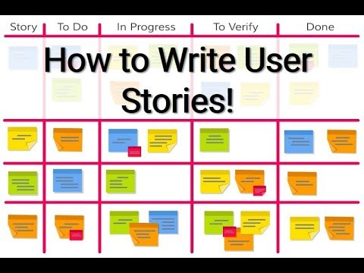
Your Card Game – User Stories

Slide 29
Your Card Game – User Stories
As a <type of user>, I want <some goal> so that <some reason>
Definition of done

Slide 30
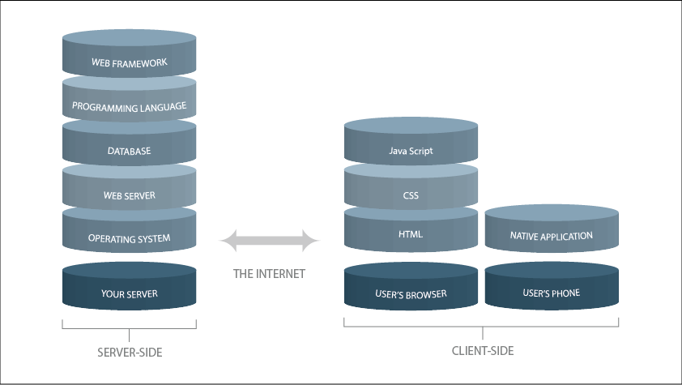
Developer View of the World

Slide 31
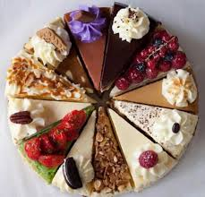
Customer View of the World

Slide 32
User Stories – Type of user
From a customer point of view
A user, customer or client
They could prioritise stories
Can do independently
Manually do previous steps

Slide 33
User Stories – Card Game
As a card player (dealer), I want to deal the cards so that the game can start
As a dealer, I want to determine the winner so I can declare a winner
As the first player, I want to play a card, so that the game progresses
As the next player, I want to play a card, so that the games progresses

Slide 34
Requirement Gathering - Overview
Scope
Prototype
Questions
Interviews
Group Meetings
User Stories

Slide 35

Lecture – Any Questions

